Slide 1
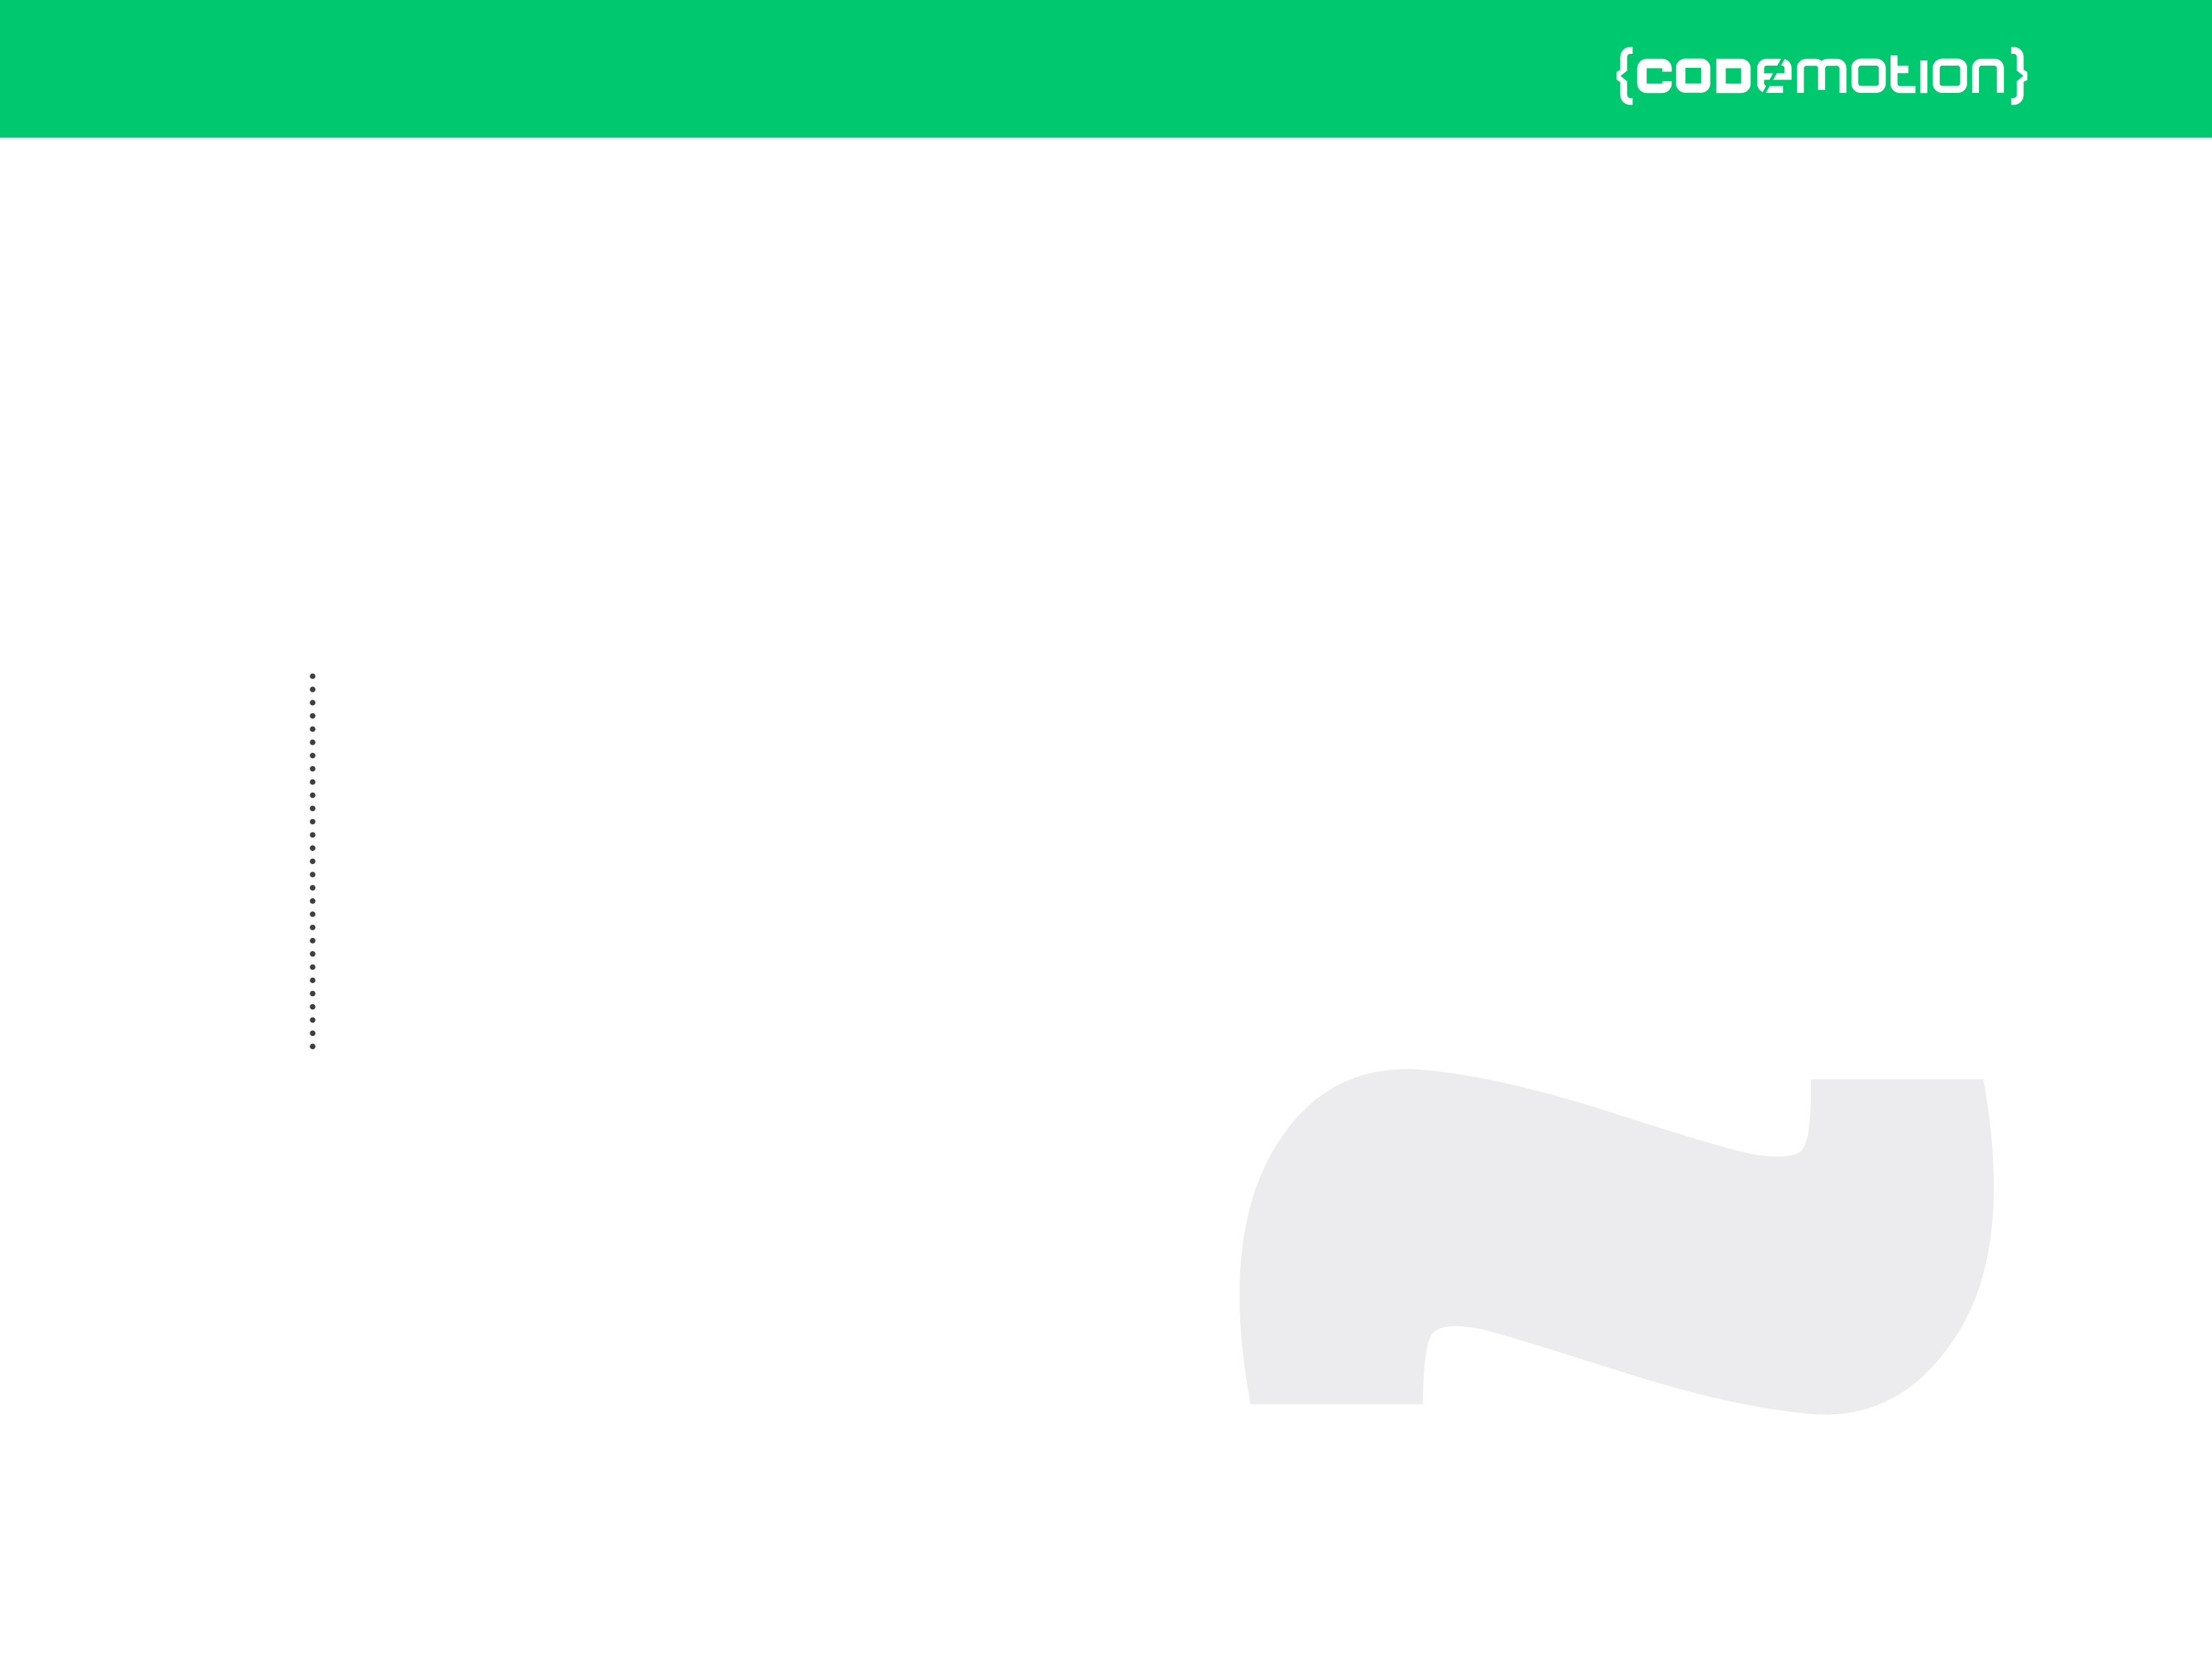



Valerio Riva
Introduction to development of multiplayer HTML5 games (with Socket.io)
valerio.riva@gmail.com
@ValerioRiva
http://it.linkedin.com/in/valerioriva/

Slide 2
Who am I?
Web developer
Game developer @ Interactive Project
MyGPTeam, MyGPTeam Turbo, OverVolt: crazy slot cars
http://interactiveproject.com/
Game Jammer
Mentor @CoderDojo Roma
https://coderdojoroma.wordpress.com/

Slide 3
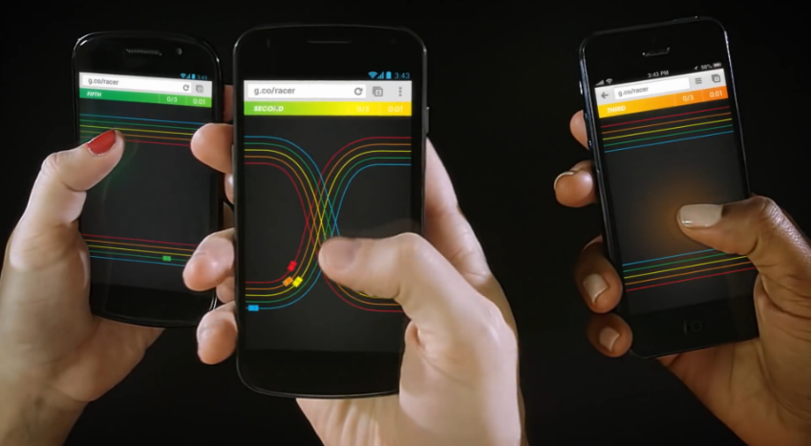
Intro
Multiplayer games!
Multiplayer architectures & technologies
Multiplayer services
Implementation of a simple multiplayer game

Slide 4
Multiplayer games
What is a multiplayer game?
Trivia Time
First multiplayer game?
Biggest (in terms of players) multiplayer game?
Pioneer multiplayer (as we know it) game?

Slide 5
Leave your feedback on Joind.in!
https://joind.in/event/view/3347

